Slide 1
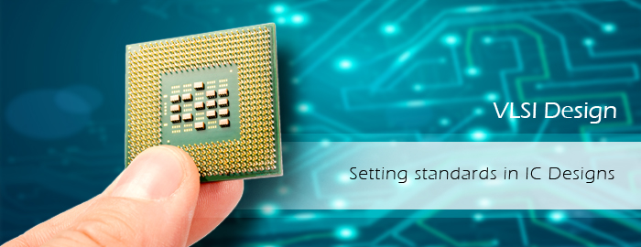
DESIGN OF NOVEL TERNERY TO BINARY

Slide 2
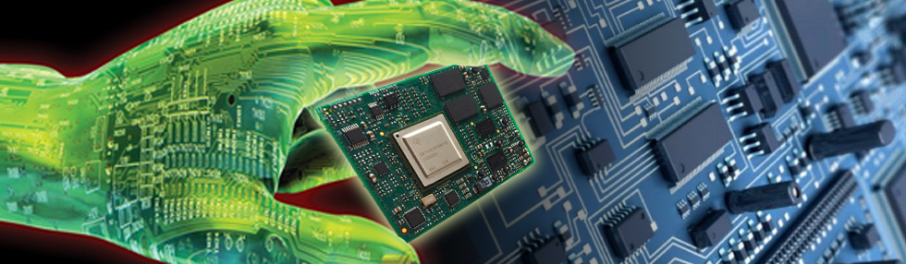

PRESENTED BY:
ABHINANDAN SHARMA
ABHINAV KUMAR
ARINJOY PODDAR
MRINAL BHARDWAJ
SHASHWAT KUMAR
SHUBHAM KUMAR SINHA
Under the guidance of :
Dr. Aloke Saha

Slide 3

